Slide 1
VIEWSTATE

Slide 2
Objectives
Stateless nature of HTTP protocol
How a webform is processed
What a ViewState is
The role of ViewState in ASP.NET
Primary difference between ASP.NET Server controls and HTML controls

Slide 3
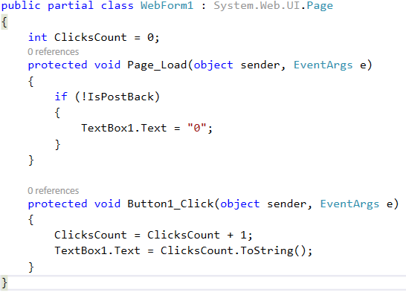
ViewState
Web Applications work on HTTP protocol. HTTP protocol is stateless protocol, meaning it does not retain state between user requests.

Slide 4
ViewState
Web forms live for barely a moment.
When a request is received
An instance of the requested webform is created
Events processed
Generates the HTML & posted to the client
The webform is immediately destroyed

Slide 5
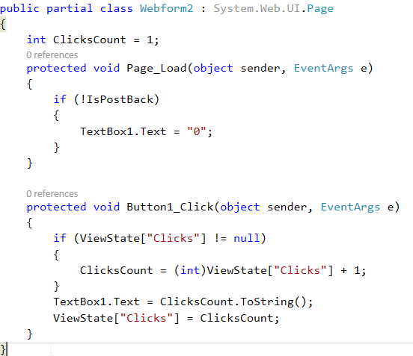
ViewState

Slide 6
ViewState
On clicking the button the value keeps increasing on every click.
This is possible because we are using the ViewState variable clicks to preserve the data between requests.
The ViewState data, travels with every request and response between the client and the web server.

Slide 7
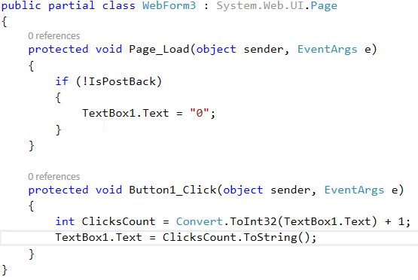
ASP.NET Server Controls & ViewState

Slide 8
Upon clicking the button, the value gets incremented as expected.
This is because, TextBox1 is an asp.net server control, that uses viewstate internally, to preserve data across postbacks.
Because Web forms have very short lifetimes, ASP.NET takes special steps to preserve the data entered in the controls on a web form.

Slide 9
Data entered in controls is sent with each request and restored to controls in Page_Init. The data in these controls is then available in the Page_Load(), Button_Click(), and many more events, that occur after Page_Init() event.

Slide 10

ASP.NET Server Controls & HTML Controls
ASP.NET server controls retains state
HTML controls do not retain state across post backs
An HTML control can be converted in ASP.NET server control, by adding runat=“server” attribute in the HTML source as shown below:
<input id="Text1" runat="server" type="text" />
ViewState data is serialized into base64-encoded strings stored in Hidden input field

